Slide 1

Foundations 4
Units 7 – 9

Slide 2
Evaluation Criteria
Written exam 35% (Listening/Voc/Grammar/Reading)
Cambridge platform 20%
Quiz 15%
Speaking exam 15%
Participations/Homework/Writings 15%

Slide 3
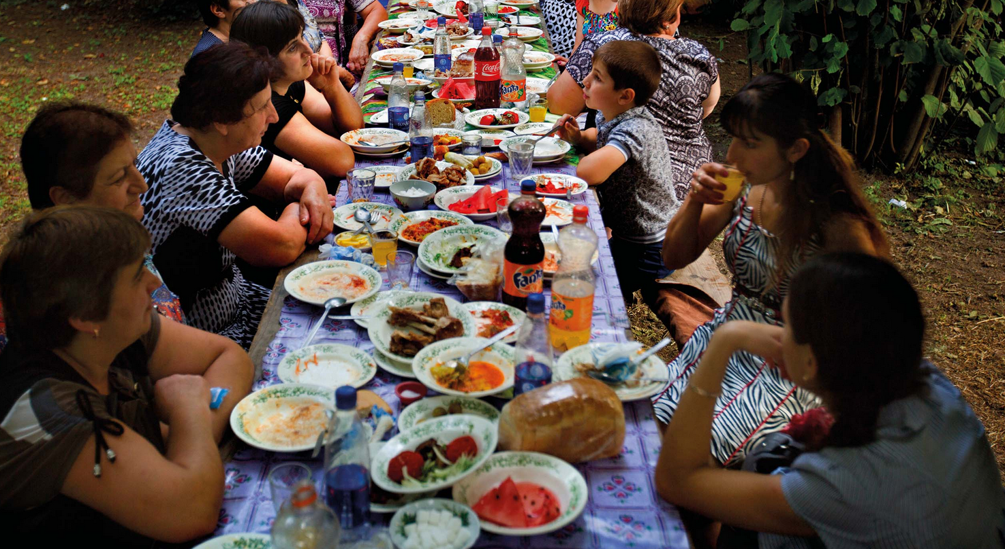
Unit 7 – Eat, drink, be happy

Slide 4
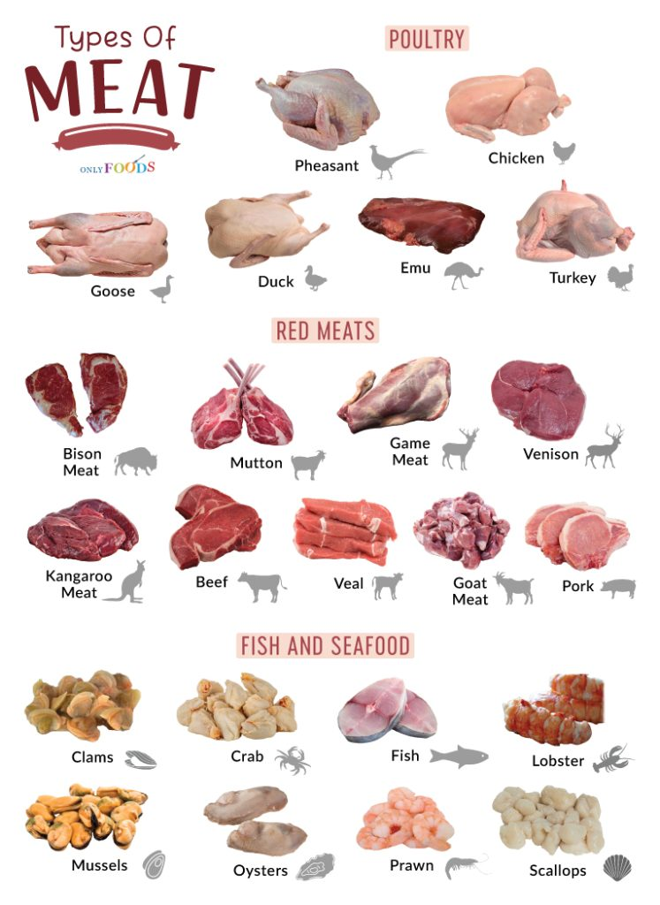
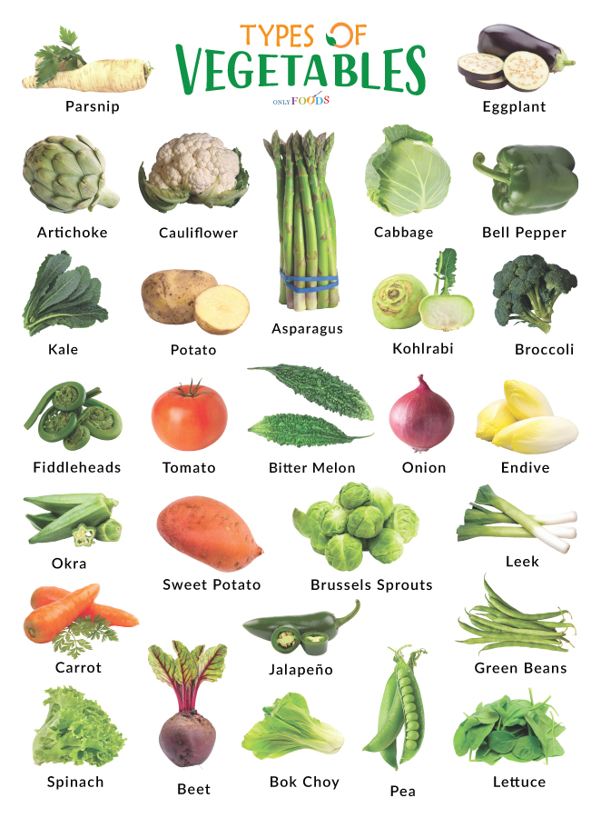
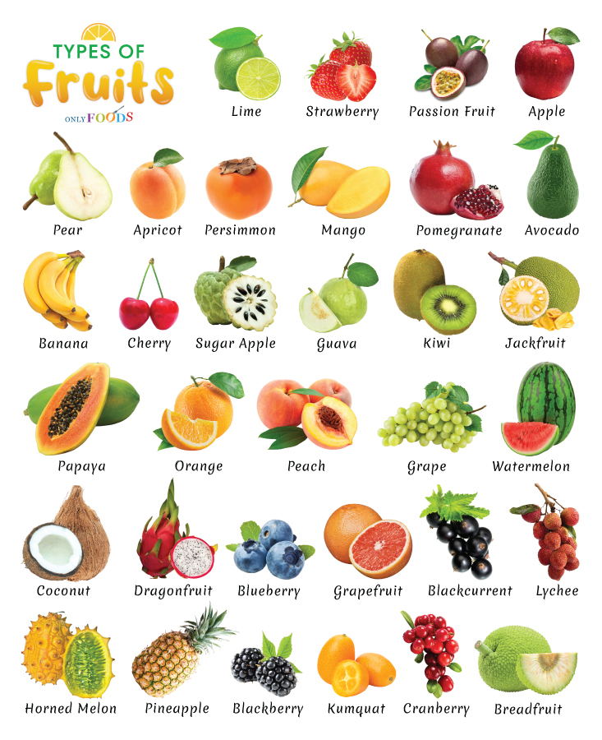

Slide 5
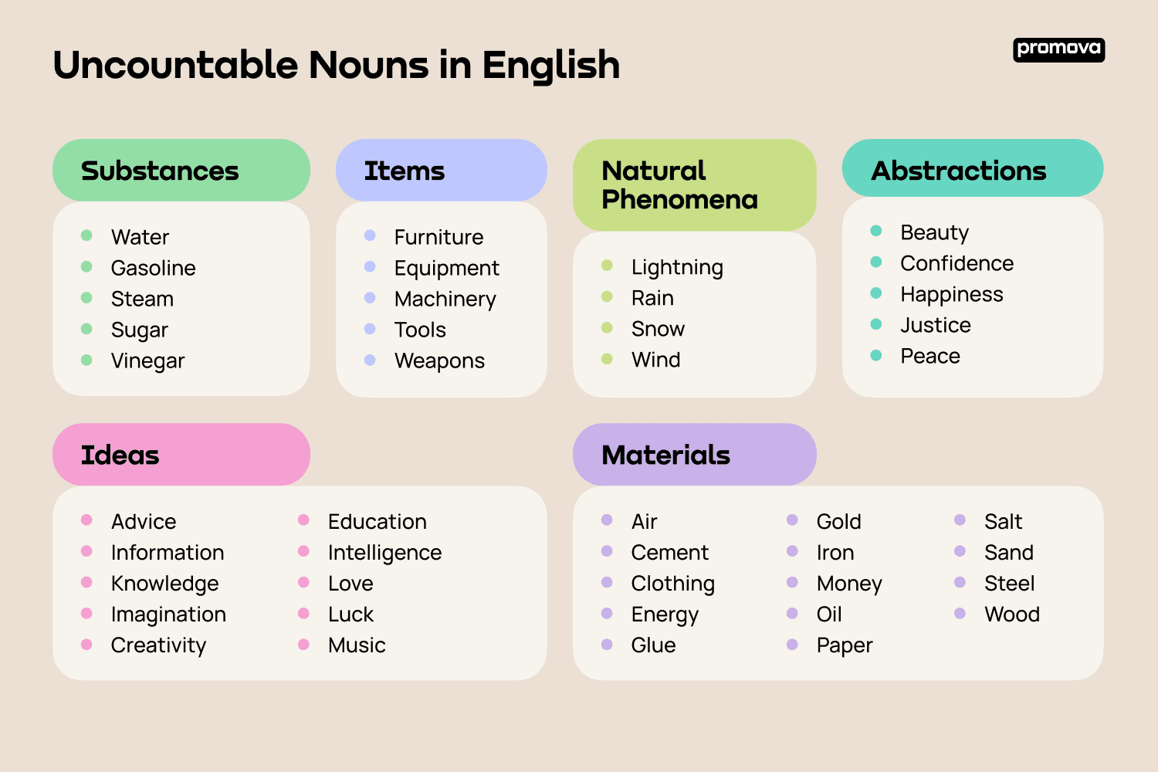
Uncountable

Slide 6
Quantifiers
Nouns | Countable | Uncountable
Quantity
Big | A lot of | A lot of
Big (Excessive) | Too many | Too much
No specific plural | Some | Some
Small | A few / Not many | A little / Not much
Singular | A / An | N/A
Open question | How many | How much
We use any to talk about plural countable nouns and uncountable nouns (negative and interrogative forms)
I don’t have any money. (Any= no)
Do you have any money? (Any = I don’t know, that’s why I ask)

Slide 7
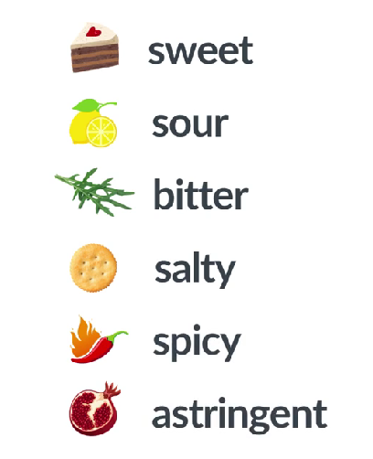
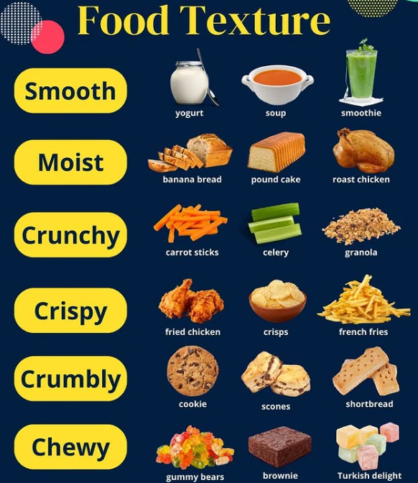
Food description
Food taste
Food textures

Slide 8
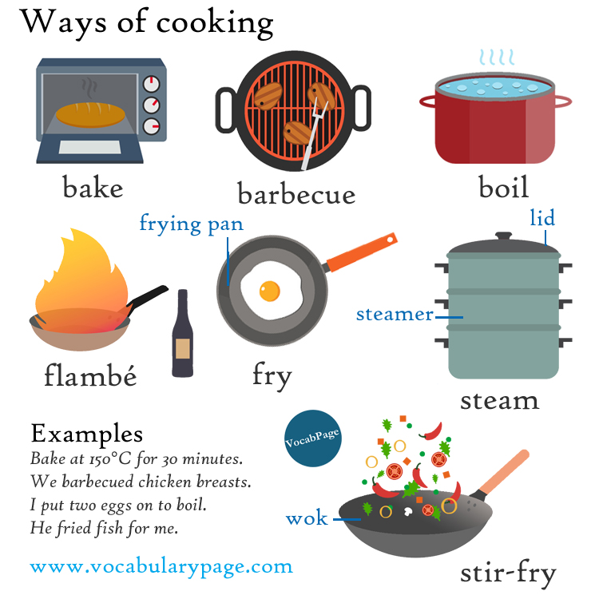
Ways of cooking

Slide 9
Verb patterns
In English, if you want to follow a verb with another action, you must use a gerund or infinitive.
Continue with to + infinitive
Continue with -ing
Agree – He agreed to help me.
Decide – They decided to leave early.
Hope – She hopes to find a new job.
Plan – We plan to visit Paris next summer.
Promise – He promised to call me later.
Refuse – She refused to apologize.
Learn – I learned to drive when I was 18.
Want – They want to buy a new house.
Need – I need to finish my homework.
Would like – She would like to join us.
Enjoy – I enjoy reading books.
Finish – He finished writing his report.
Avoid – She avoids eating fast food.
Consider – We consider moving to another city.
Mind – Do you mind helping me?
Keep – He keeps talking during the lesson.
Suggest – She suggested going to the beach.
Admit – He admitted stealing the money.
Deny – She denied knowing him.
Miss – I miss seeing my old friends.

Slide 10
Ordering food in a restaurant
Ordering food | Taking an order
I’ll have the (food), please. | Are you ready to order?
 | Can I get you (food)?
Asking questions about food | Checking wit customers
What do you recommend? | Was everything OK for you today?
What does it come with? | Asking for the check
What kind of (dressing) does it come with? | Can I have the check?

Slide 11
How to Express Your Opinion in English
Common Phrases
I think…
Formal Phrases
I believe…
I feel…
In my opinion…
I would say…
From my point of view…
From my perspective…
In my view…
It seems to me that…
There are different ways to express your opinion, like:

Slide 12
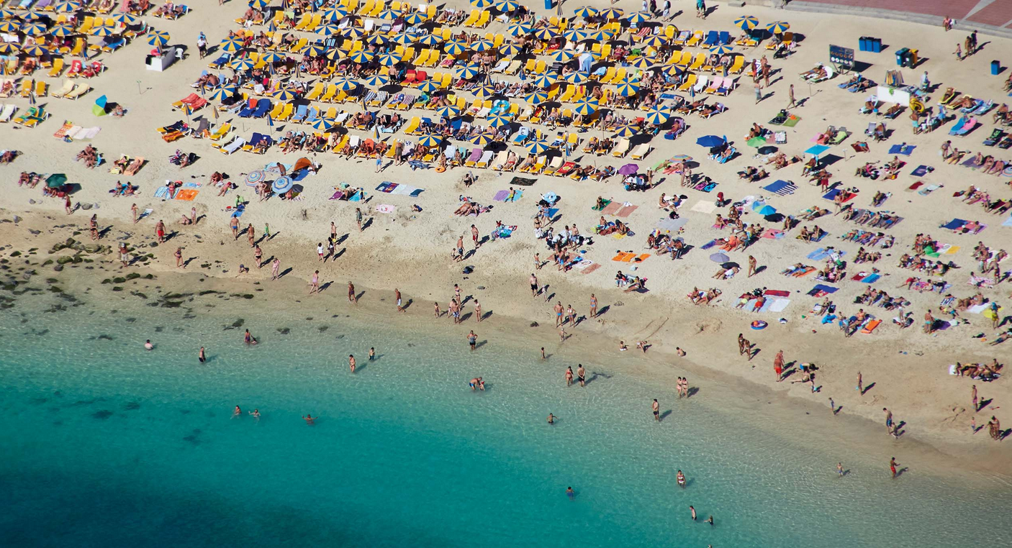
Unit 8 – Trips

Slide 13
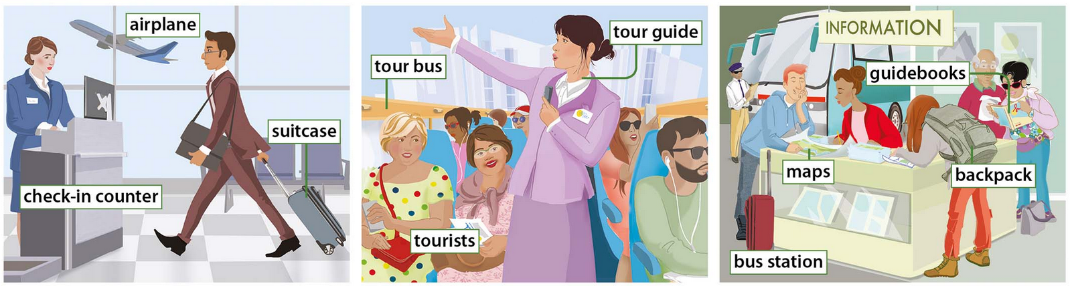
Traveling

Slide 14
Zero conditional
We use the zero conditional to talk about things that are real in a specific situation.
There are two types of sentences, a condition and a result.
We use the simple present in both. Also, both can be affirmative or negative.
To ask a question, we always ask for the result.
Condition | Result
When I have free time, | I like to watch TV.
Result | Condition
I like to watch TV | When I have free time.

Slide 15
When vs If
We can use if or when in zero conditional to introduce the conditions.
We use if to introduce a possible or unreal situation or condition.
We use when to refer to the time of a situation or condition that we are certain of.
Condition | Result
When I have free time, | I like to watch TV.
Result | Condition
I like to watch TV | If I have free time.

Slide 16
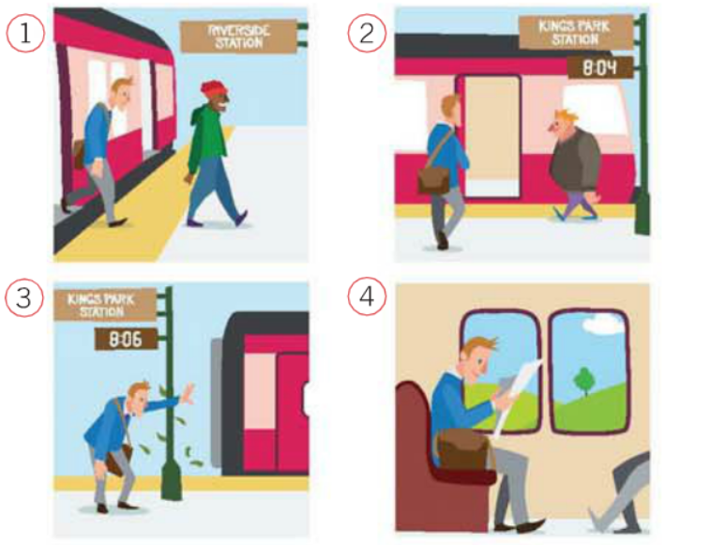
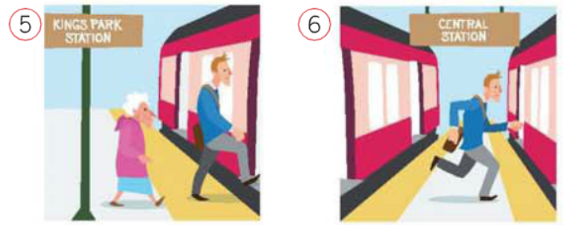
Transport collocations
Take the train
Get on the train
Change train
Catch the train
Get off the train
Miss the train

Slide 17
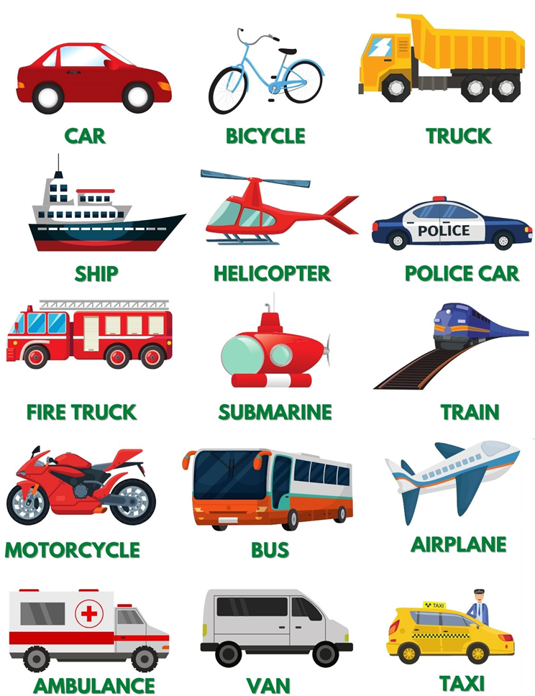

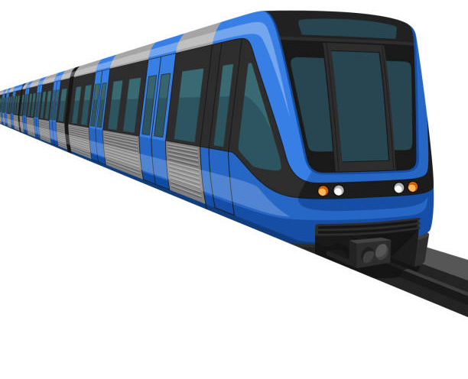
Transport
Public transport
SUBWAY

Slide 18
Giving reason using to and for
Giving reason with “to”
Giving reason with “for”
When we give a reason with “to”, we use an infinitive verb after “to”.
I play soccer to relax after work.
When we give a reason with “for”, we use a verb -ing or and object after “for”.
I play soccer for relaxing.
I eat a sandwich for lunch.

Slide 19
Advice and suggestions.
Giving advice and making suggestions.
Responding to advice and suggestions.
How about _______?
After “about”, we use an object or a verb -ing.
Why don’t (subject) ______?
After the subject we use an infinitive verb
(Subject) should _______.
Should (subject) ______?
After “should” we use an infinitive verb.
That’s a great idea.
That would be great!
Perfect!

Slide 20
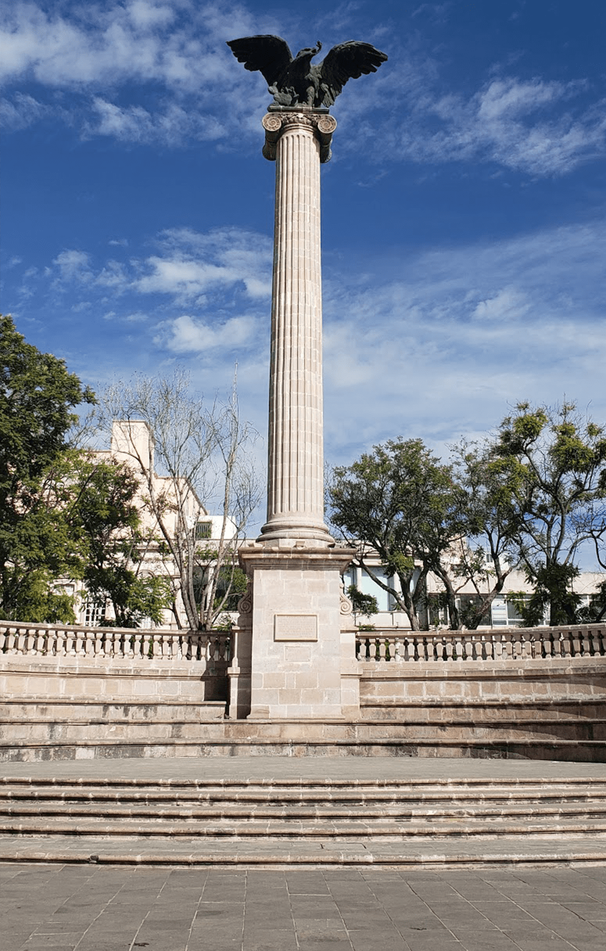
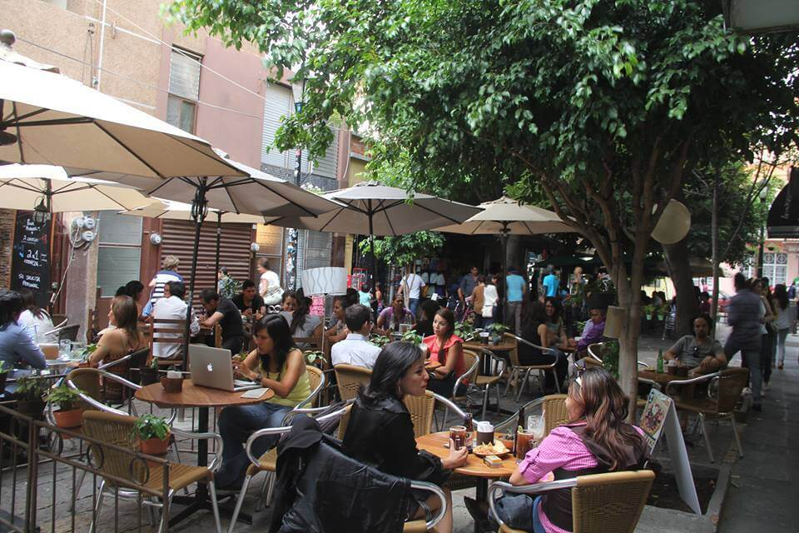
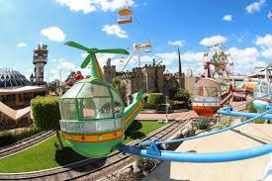
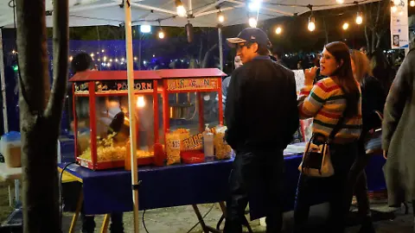
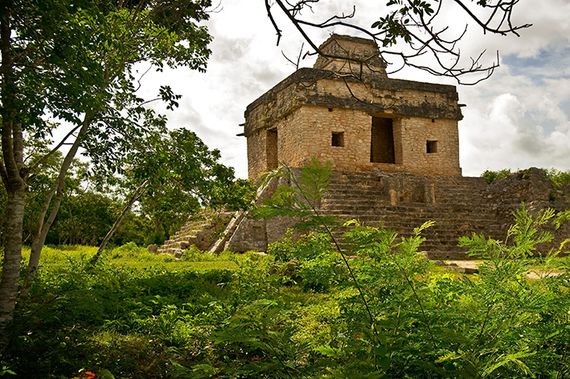
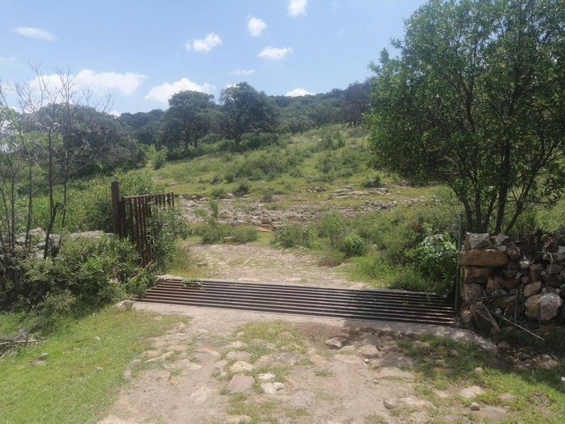
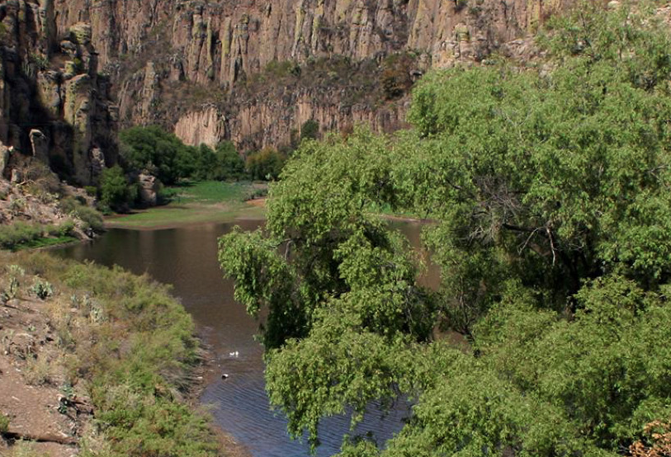
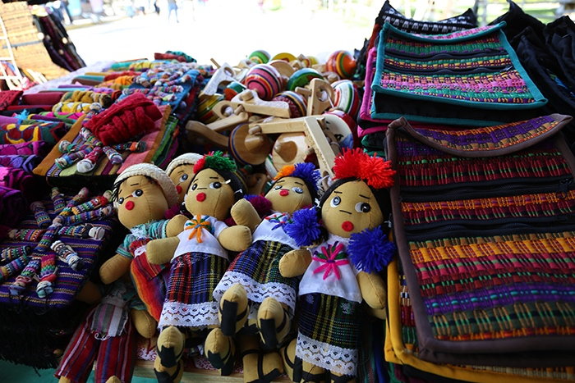
Sights in a city
Tourist Attraction
Backstreets
Amusement Park
Food market
Ruins
Hiking trail
Natural reserve
Crafts fair

Slide 21
Things that happen when traveling abroad
Move on – Start doing something new.
Adjust – Transform something into your habit.
Fit in – Be accepted as a similar by a group of people.
Stand out – Be easily noticeable by other.
Cut down – Reduce the amount.
End up – Be in a particular situation after doing something.
Set up – Arrange something to happen.

Slide 22
Express agreement
To agree
So do I.
To disagree (Informal)
I disagree!
Me too.
Definitely.
I agree.
I couldn’t agree more.
I don’t agree.
Yeah, but…

Slide 23
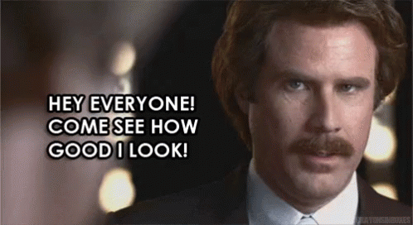
Unit 9 – Looking good

Slide 24
Comparatives
We us the comparatives to compare one object or group with another one.
America is better than Chivas.
Mexican food is more delicious than American food.
Mike is shorter than Ramon.
When using comparatives is important to use “than” to indicate the object you compare to.
Adjectives | Rule | Example
One syllable | Add -er at the end of the adjective | Small – Smaller Smart - Smarter
 | If the adjective ends “Consonant + Vowel + Consonant”,, double last consonant and add -er. | Big – Bigger Hot – Hotter Sad - Sadder
Ending -y | Substitute “y” with “i”, add “-er”. | Happy – Happier Dry - Drier
Two or more syllables | Add “more” before the adjective. | Beautiful – More beautiful Intelligent – More intelligent
There are some irregular adjectives such as:
Good - Better
Bad - Worse
Old- Older/Elder
Far – Farther/Further

Slide 25
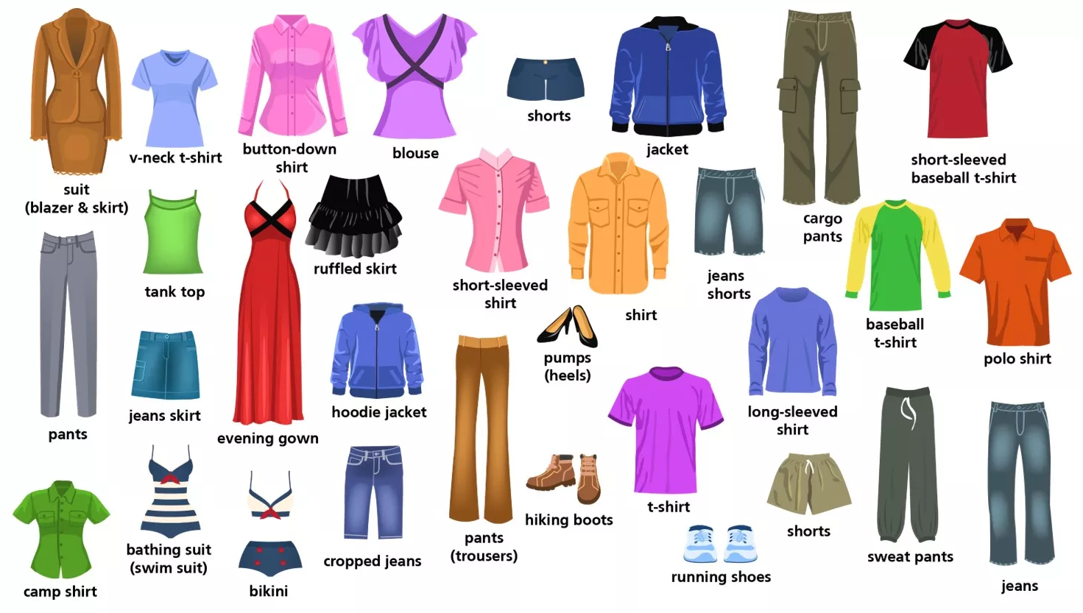
Clothing

Slide 26
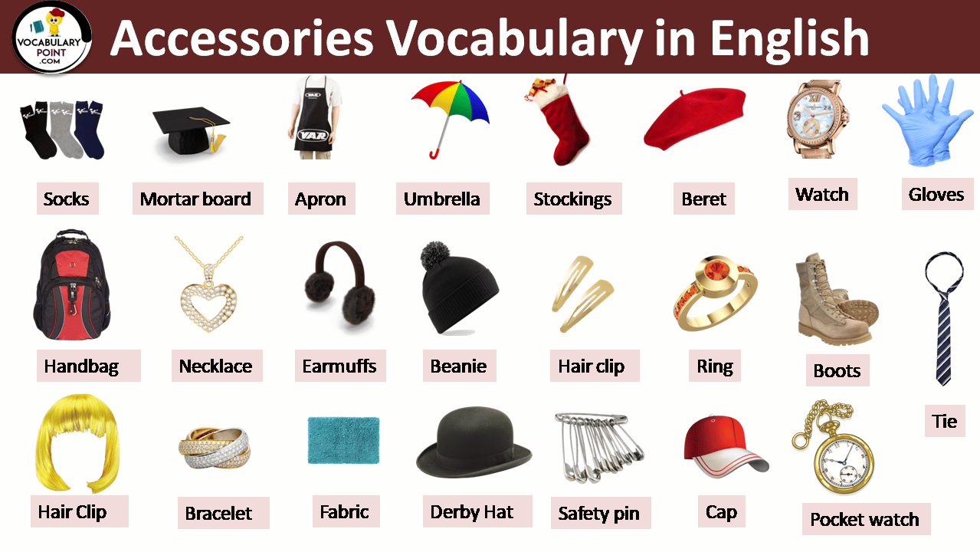
Accessories

Slide 27
Superlatives
We us the superlatives to indicate the #1 of a big group or many things.
America is the best soccer team in Mexico.
Mexican food is the most delicious food.
Mike is the shortest of the group.
When using superlatives is important to use “the” before the adjective.
Adjectives | Rule | Example
One syllable | Add -est at the end of the adjective | Small – The smallest Smart – The smartest
 | If the adjective ends “Consonant + Vowel + Consonant”,, double last consonant and add -est. | Big – The biggest Hot – The hottest Sad – The saddest
Ending -y | Substitute “y” with “i”, add “-est”. | Happy – The happiest Dry – The driest
Two or more syllables | Add “most” before the adjective. | Beautiful – The most beautiful Intelligent – The most intelligent
There are some irregular adjectives such as:
Good – The best
Bad – The worst
Far – The farthest/furthest

Slide 28
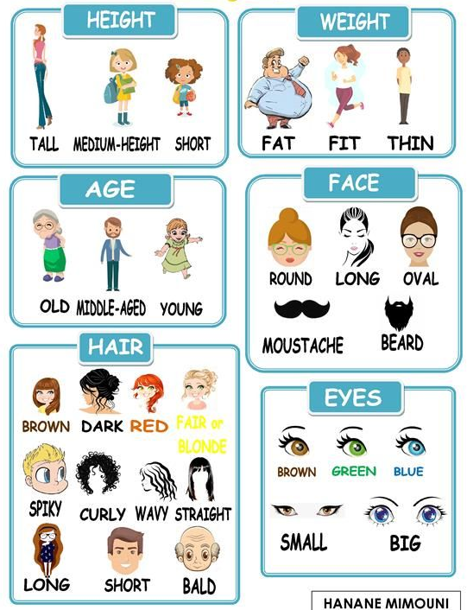
Describing people’s appearance

Slide 29
Asking for an opinion
Asking for opinion | Giving a positive opinion | Giving a negative or neutral opinion
What do you think of ___? | It looks ______ | Don’t you think ____?
How do you feel about ___? | I prefer ______ | I’m not sure.
Do you think ____? | It’s Perfect! | I guess [Not sure]
 | That/This one is ______ | Isn’t it _______?

Slide 30
Adjectives to describe clothes
Stylish
Fashionable
Comfortable
Versatile
Trendy
Durable
Elegant
Modest
Contemporary
High-quality
Colorful
Unique
*We use “go with” to indicate two things match up.

Slide 31
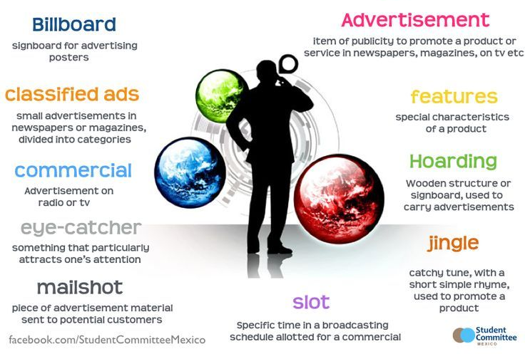
Advertising

